Slide 1
Future EC Prediction
(The lack of) Progress so far…
Muhammad Ali
MS Biology
NYU Downtown

Slide 2

Goals for this Project
Compiling accurate metadata (identified 1,384 samples)
Predict EC (diagnosis) from Infinium HM450/850 – (450k – 850k CpGs, respectively)
Predict Future EC from Infinium HM450/850 (survival analysis)
Identify CpGs associated with EC prediction – functional analysis
Create an EpiScore
Correlate with (single-cell)transcriptomics, proteomics, and genome organization (ATAC/Hi-C)

Slide 3
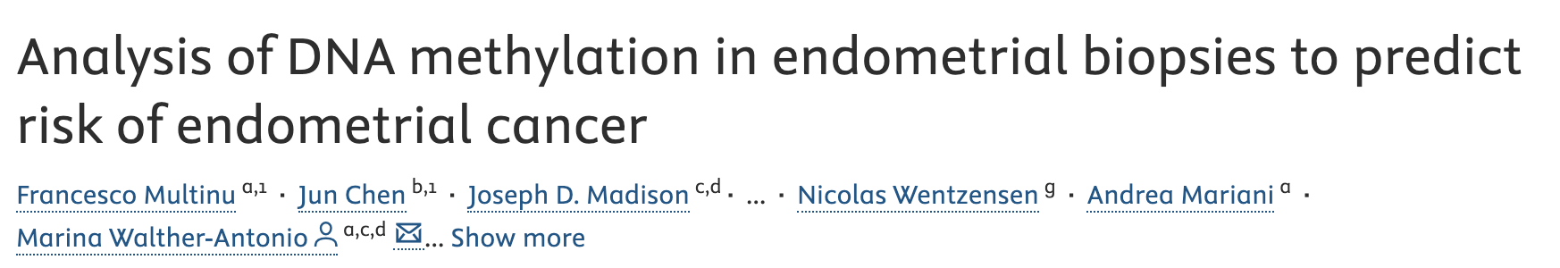

DNA Methylation to Predict Future EC
* Read the fine print
March 2020 (fairly recent)
Predicted future EC from benign endometrial biopsy using 2 genes:
ADCYAP1 (AUC: 0.71) and HAND2 (AUC: 0.83)
Claim future EC prediction up to 9 years:
median time: 1 year; range: 2 days – 9 years
They used 26 loci across 4 genes (only 2 genes statistically significant*)
They used a “linear regression model with an interaction term… future diagnosis of EC”.
Notes:
“A linear regression model with an interaction term was used to test for the effect of biopsy histology on gene methylation and its interaction with the future diagnosis of EC.”

Slide 4
Accession | Number of Samples | Type of Data | Number of Probes | Tissue
GSE136791 | 103 | DNAm EPIC | 850,000 | Endometrial tumor
GSE138072 | 32 | DNAm EPIC | 850,000 | MSC Cancer and Non-cancer
GSE155311 | 33 | DNAm EPIC | 850,000 | STIC/HGSC and adjacent normal fallopian tube (same patient)
GSE155760 | 96 | DNAm EPIC | 850,000 | HGSOC, non-HGSOC malignant, and controls
GSE178610 | 80 | DNAm EPIC | 850,000 | Patients with EEC
GSE243303 | 91 | DNAm EPIC | 850,000 | Precursor lesions of EEC
GSE263434 | 283 | DNAm EPIC, RNA-seq, CNV | 850,000, 37,000 genes | HGSC or HGEC
GSE67116 | 96 | DNAm HM450 | 450,000 | Hyperplasia and EC
GSE89093 | 92 | DNAm HM450 | 450,000 | Monozygotic twins (1 cancer and 1 healthy)
GSE90060 | 34 | DNAm HM450 | 450,000 | Different time points in the menstrual cycle of healthy women
TCGA-UCEC | 444 | DNAm HM450, RNA-seq, CNV | 450,000, ~30,000 genes | Endometrial tumors
Total | 1,384 (1260 cancer - 124 healthy) |  | DNAm (1,384) + RNA-seq (727) + CNV (727) | -

Slide 5
What I Did so Far
Cleaned up the data
Built the following (bootstrapped) models:
Penalized Cox proportional hazards model
Random Survival Forests
Random Forest Classifiers
Penalized Logistic Regression
Differential expression analysis ( ~ Death * Overall Survival)
Feature engineering using weighted sums of CpGs x genes
Methylation and RNA-seq based psuedotime analysis
Projecting the total methylation along with psuedotime

Slide 6


Data Cleaning Steps
TCGAbiolinks
GEOquery
Metadata & β values
IDATs & Metadata
sesame
Clean-up metadata;
Grouped by “case_submitter_id”
Generating β values
Grueling metadata clean-up
Column names changed to match “case_submitter_id”
Matrix columns renamed to GEO Sample Accession (GSM)
Combined, Cleaned Metadata – the holy grail

Slide 7

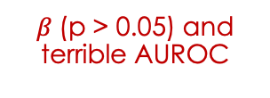
Analysis (Diagnosis Prediction)
Diagnosis Prediction
ADCYAP1 & HAND2 and probes associated with these genes
Speculative
Logistic regression using mean methylation of genes
Bootstrapped Penalized logistic regression using probes associated with these genes
Random forest based Classifier
Maybe a self-supervised Loss function might help in identifying new patterns
Non-zero CpGs
Mean-importance filtering
$β$(p > 0.05) and terrible AUROC
Logistic regression using identified features
Ensemble Method for Feature Selection
$β$(p > 0.05)

Slide 8
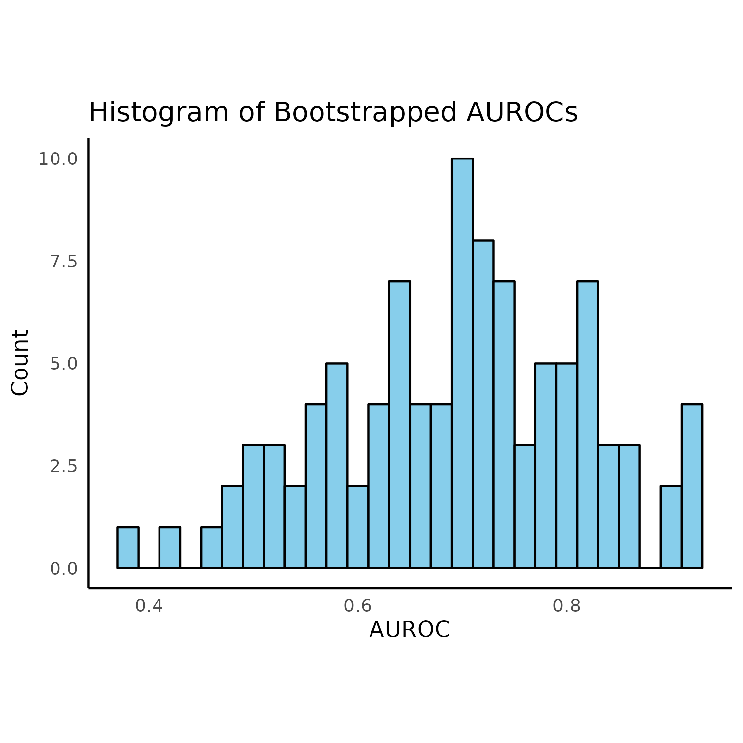
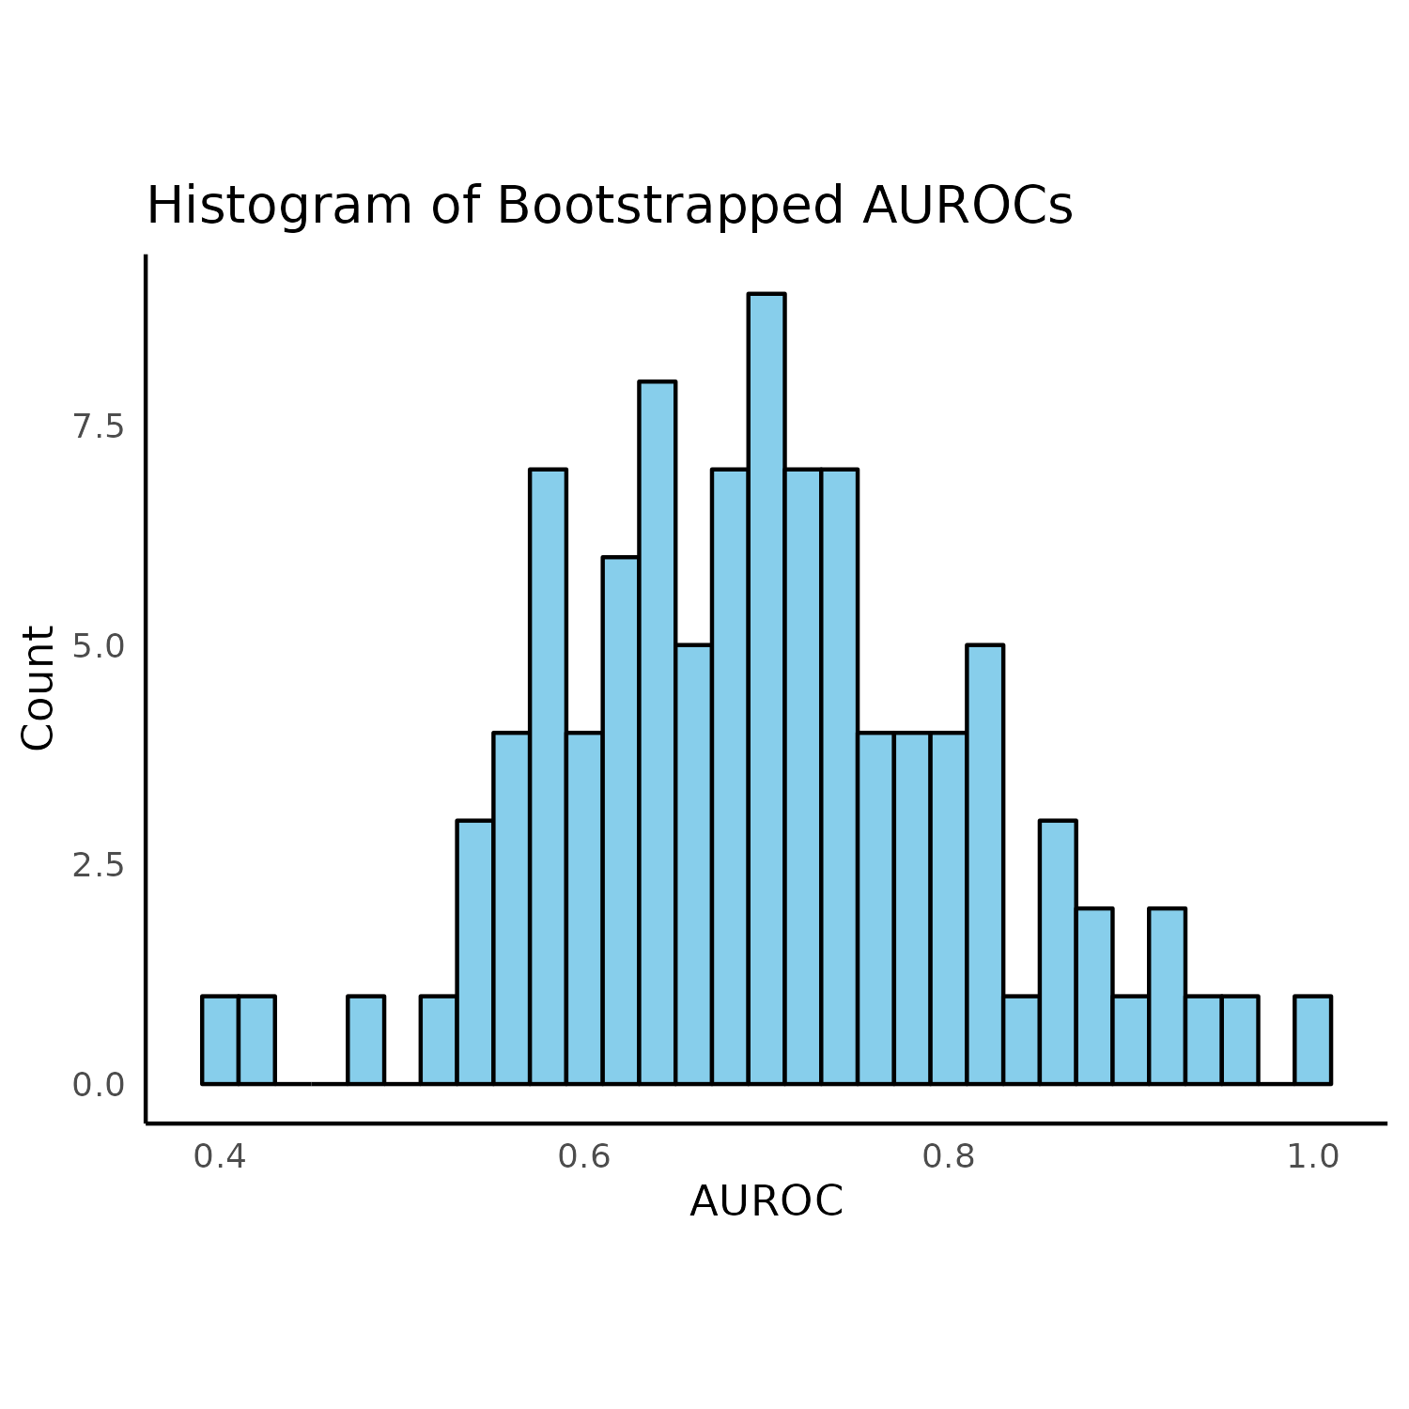
Diagnosis NOT Robust with Linear Models
Dataset: GSE89093
Monozygotic twins
One healthy | One EC
Reported AUC:
ADCYAP1 (AUC: 0.71)
HAND2 (AUC: 0.83)
Mean AUC I calculated:
ADCYAP1 (AUC: 0.69)
HAND2 (AUC: 0.70)
Based on all CpGs labeled for that gene
Model: penalized logistic regression (elastic-net) – 100 bootstraps
ADCYAP1
HAND2

Slide 9
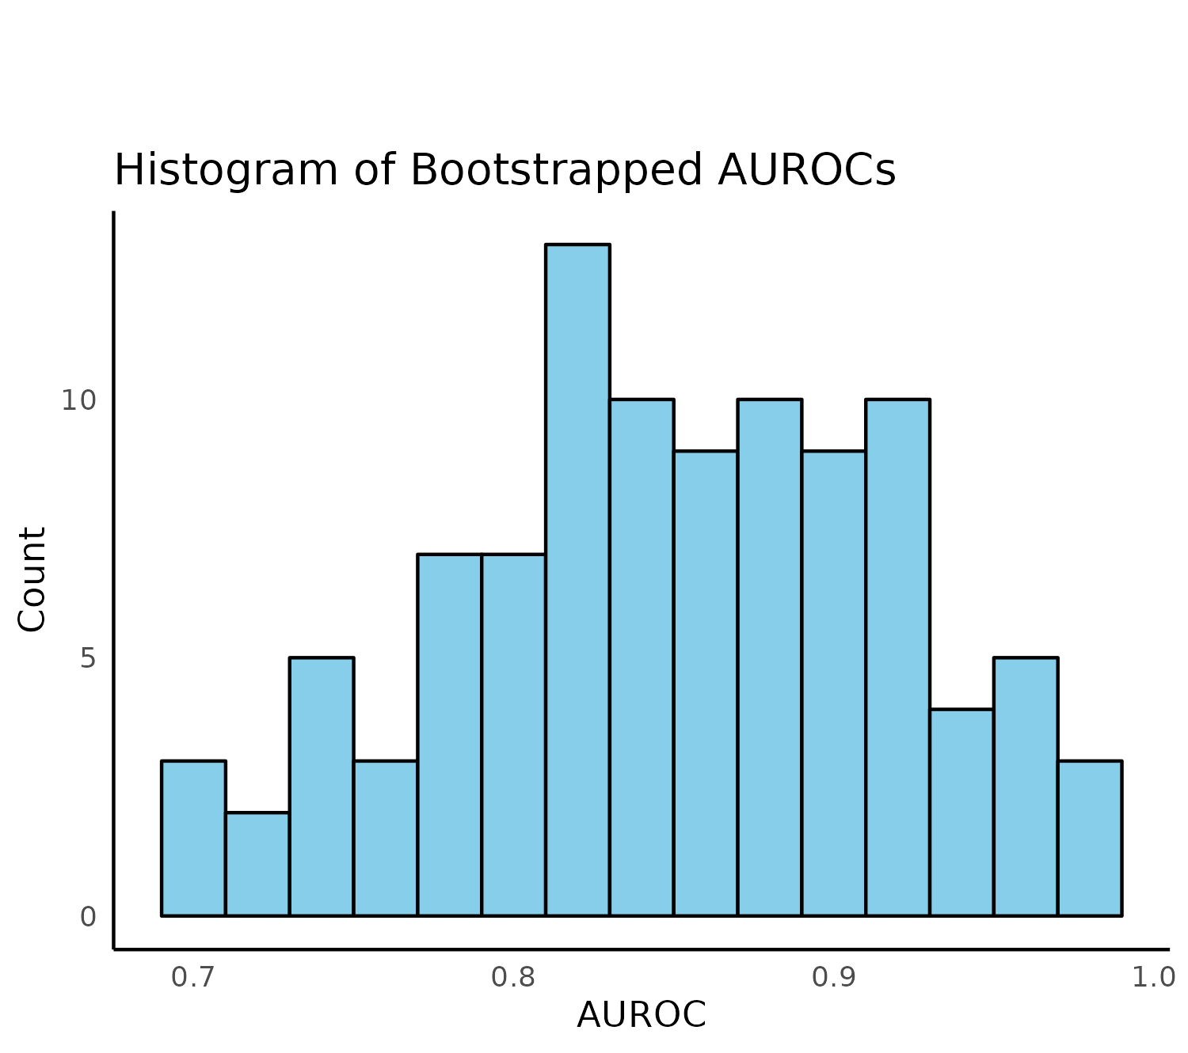
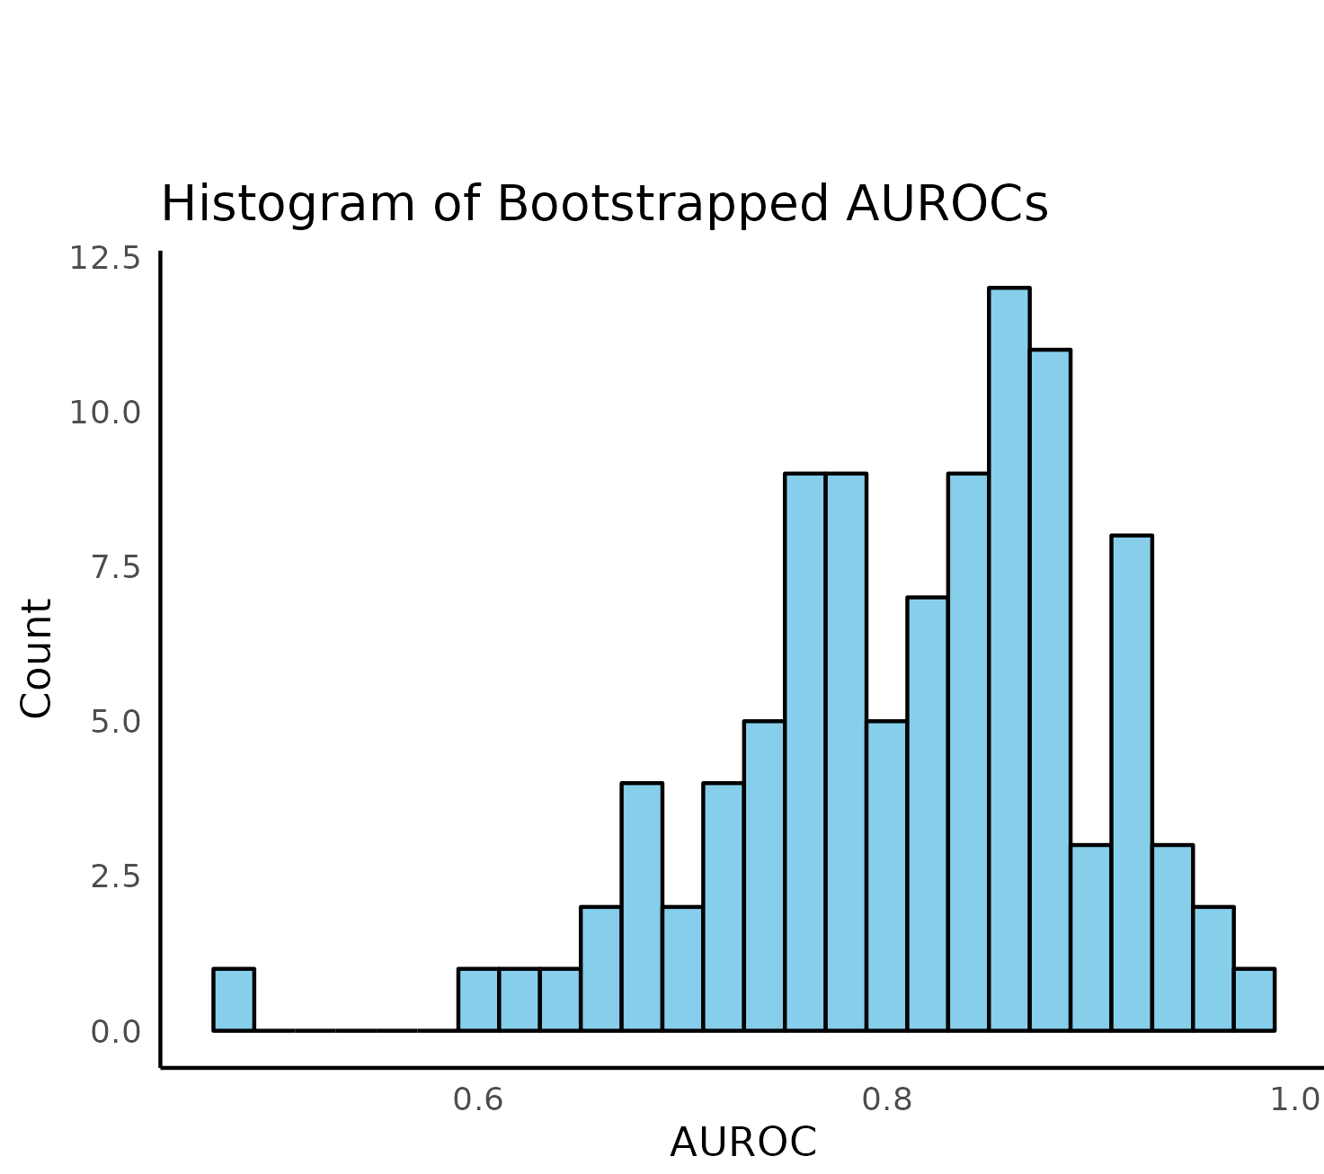
Diagnosis Better with a Non-linear Model
Dataset: GSE89093
Monozygotic twins
One healthy | One EC
Reported AUC:
ADCYAP1 (AUC: 0.71)
HAND2 (AUC: 0.83)
Mean AUC I calculated:
ADCYAP1 (AUC: 0.85)
HAND2 (AUC: 0.81)
Both together (AUC: 0.81)
Model: random Forest (5000 trees) – 100 bootstraps
ADCYAP1
HAND2

Slide 10
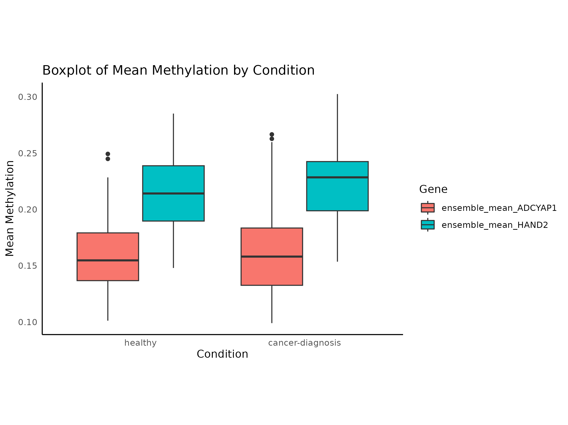
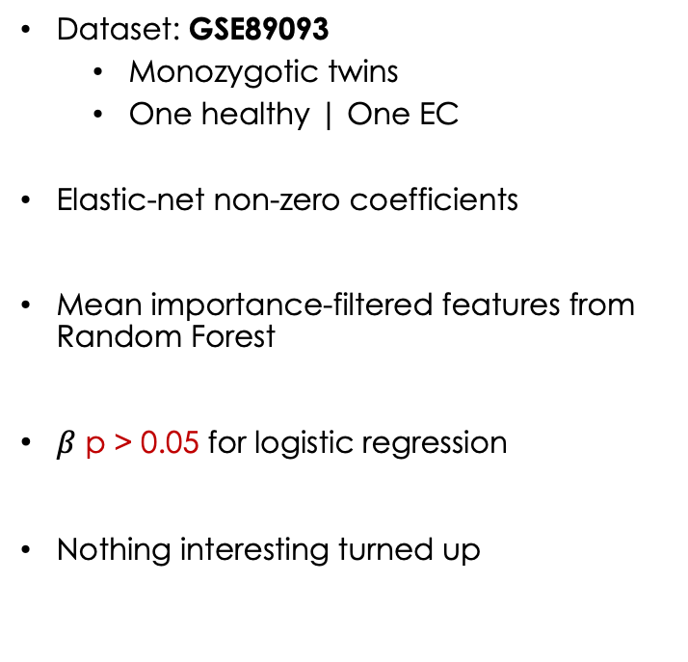
Ensemble Method for Feature Selection
Dataset: GSE89093
Monozygotic twins
One healthy | One EC
Elastic-net non-zero coefficients
Mean importance-filtered features from Random Forest
$β$ p > 0.05 for logistic regression
Nothing interesting turned up
ADCYAP1
HAND2

Slide 11
Analysis (Survival Prediction)
Survival Prediction
Speculative
Penalized cox proportional hazards model using all probes
Random survival forests using CpGs from ADCYAP1 and HAND2
Psuedotime analysis using methylation
What I want to see: If there are any differential molecular markers in people who survive longer compared to those who don’t?
Shows different methylation profiles for serous and endometrial adenocarcinomas
Takes very long and returns like 6 CpGs
How can I investigate it further: honestly? No clue. Plis help ;-;

Slide 12
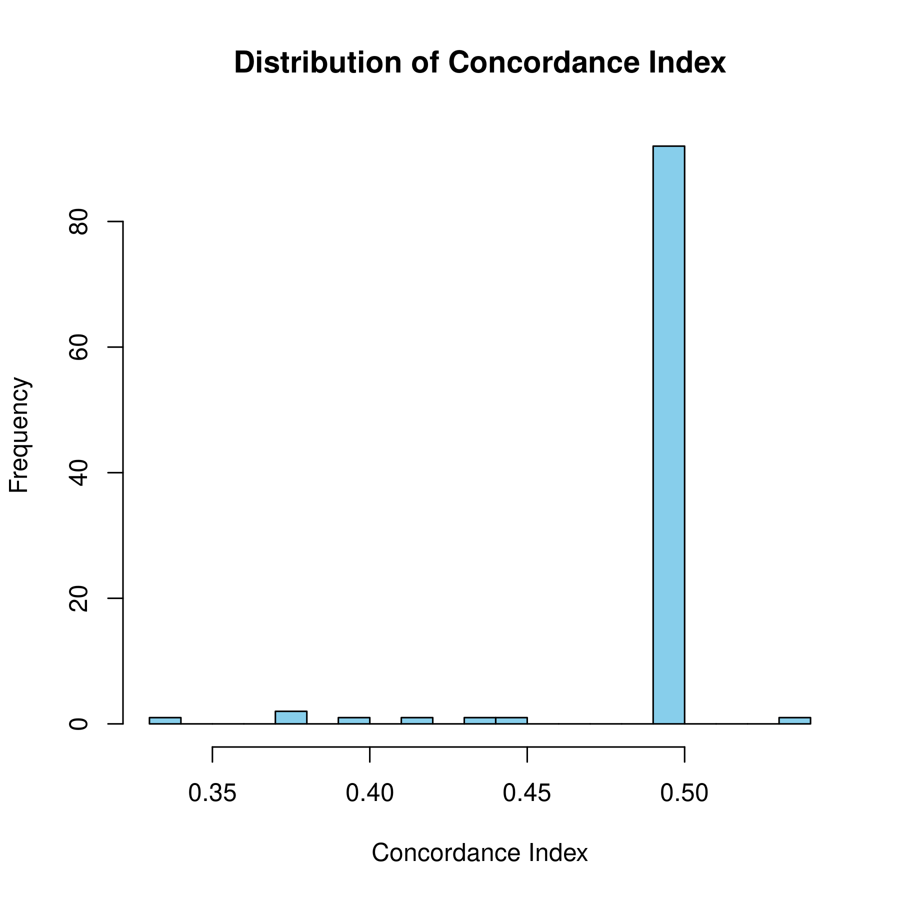
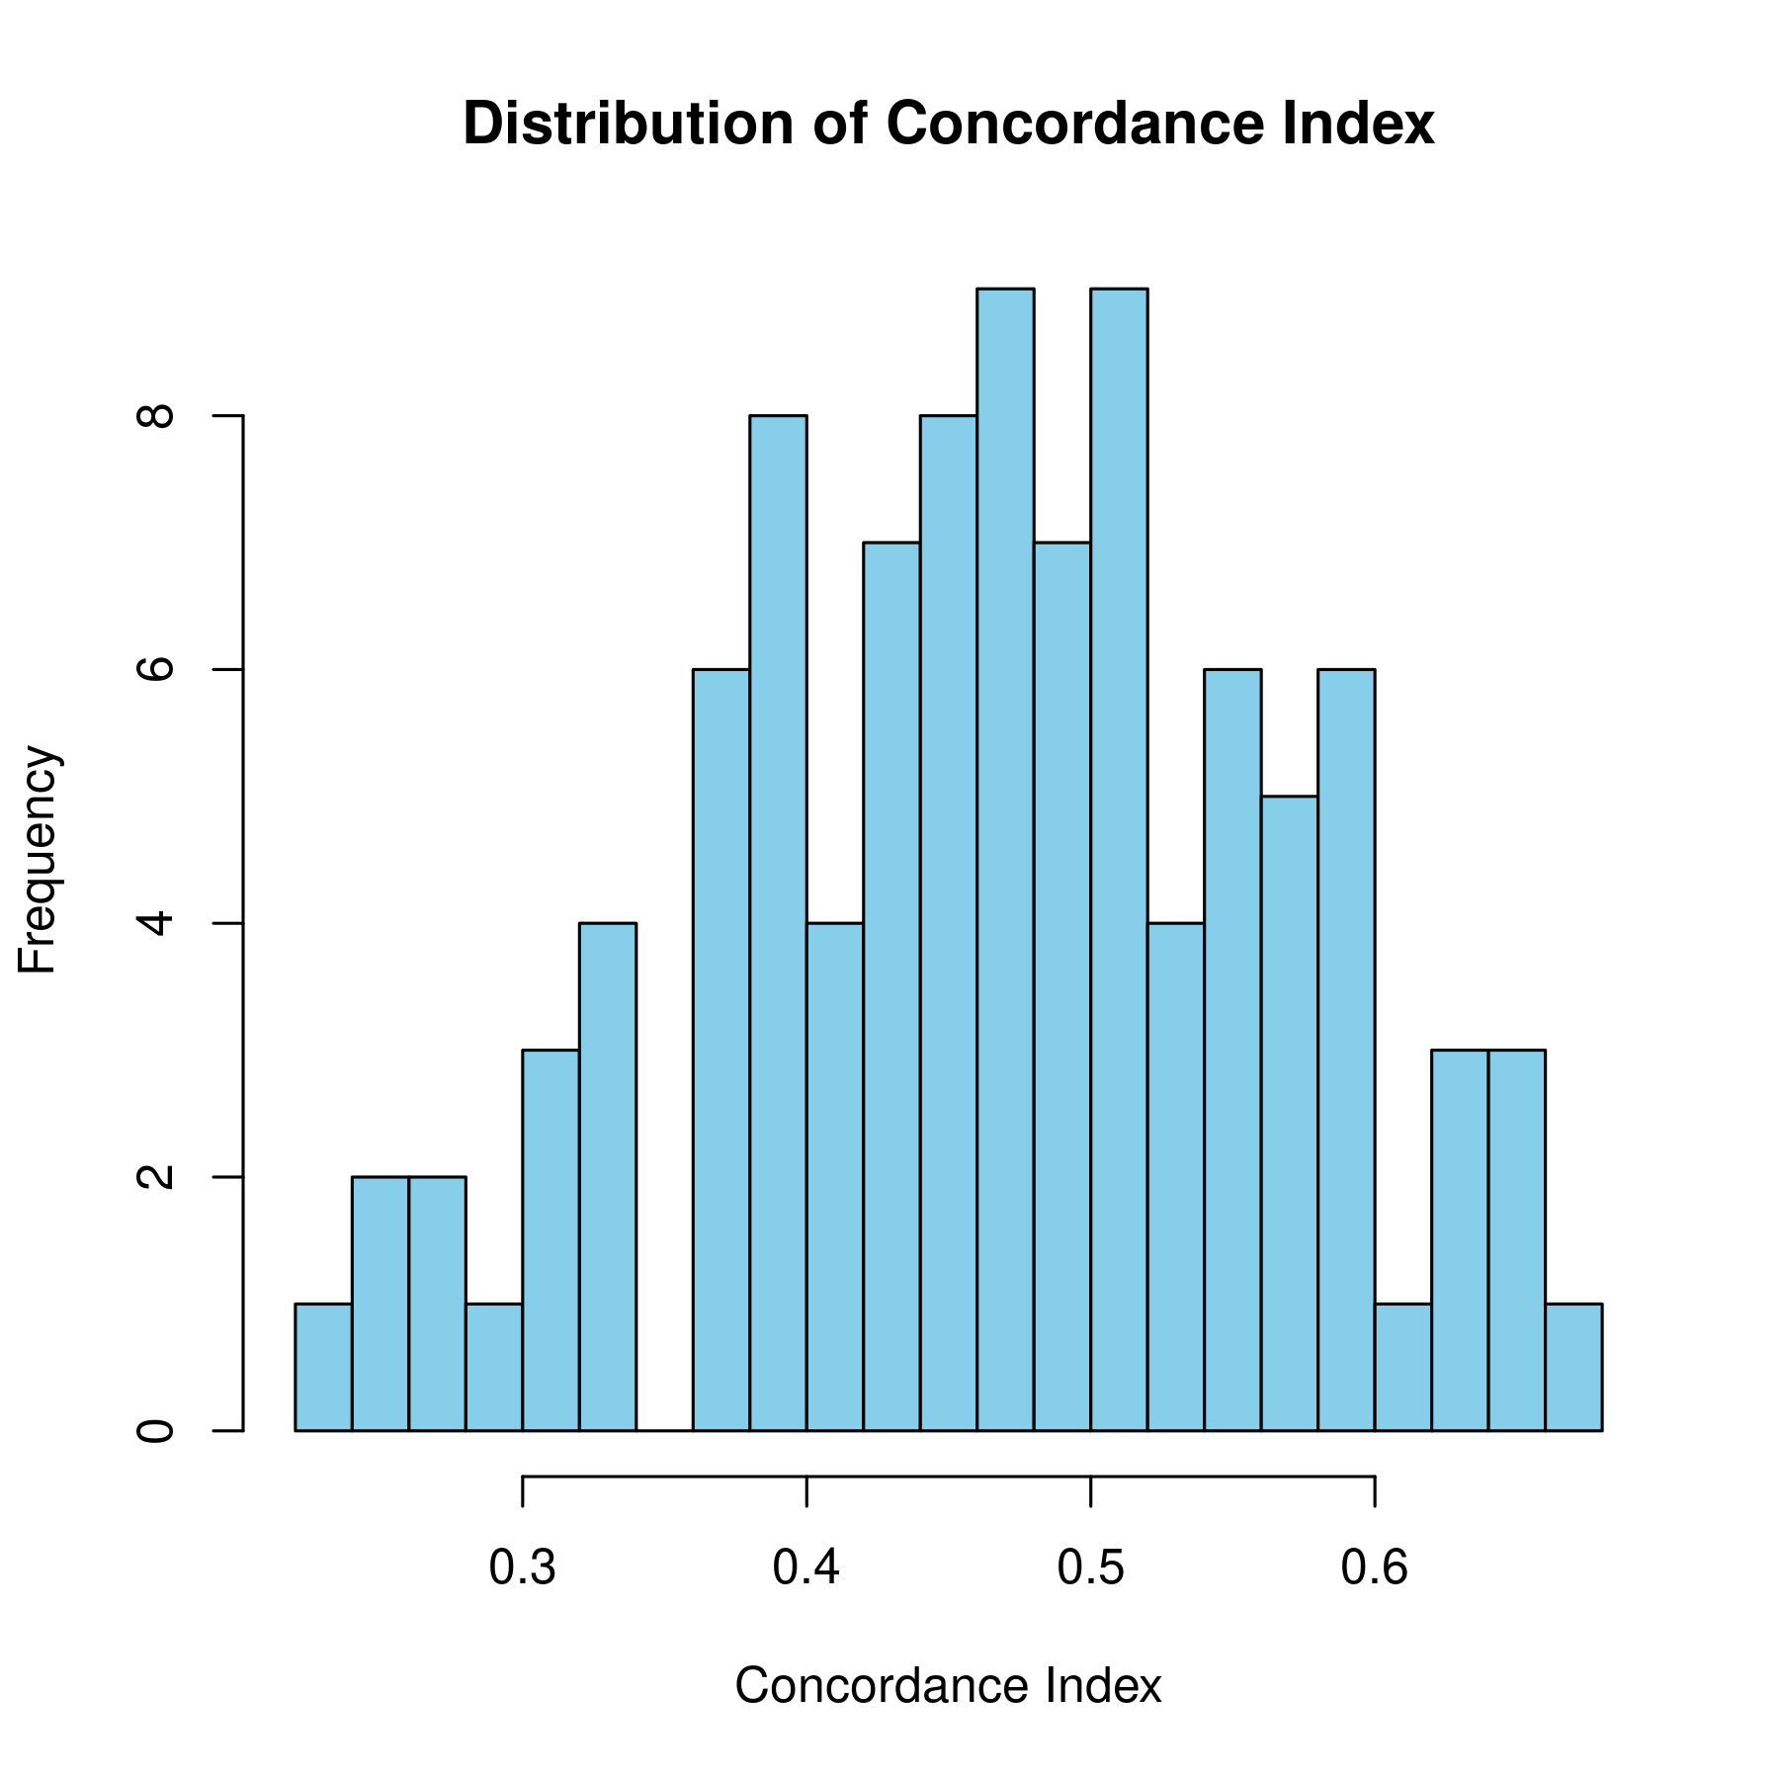
Survival Analysis
ADCYAP1 Elastic-net
Bootstraps: 100
A more flexible model produced larger values of CI.
There’s a non-linear relationship between survival and DNAm.
Switched to non-linear random survival forest (RSF).
Tried the following with all CpGs:
Ridge with both ADCYAP1 and HAND2.
RSF with ADCYAP1 and HAND2 individually.
RSF with both A DCYAP1 and HAND2.
ADCYAP1 Ridge

Slide 13
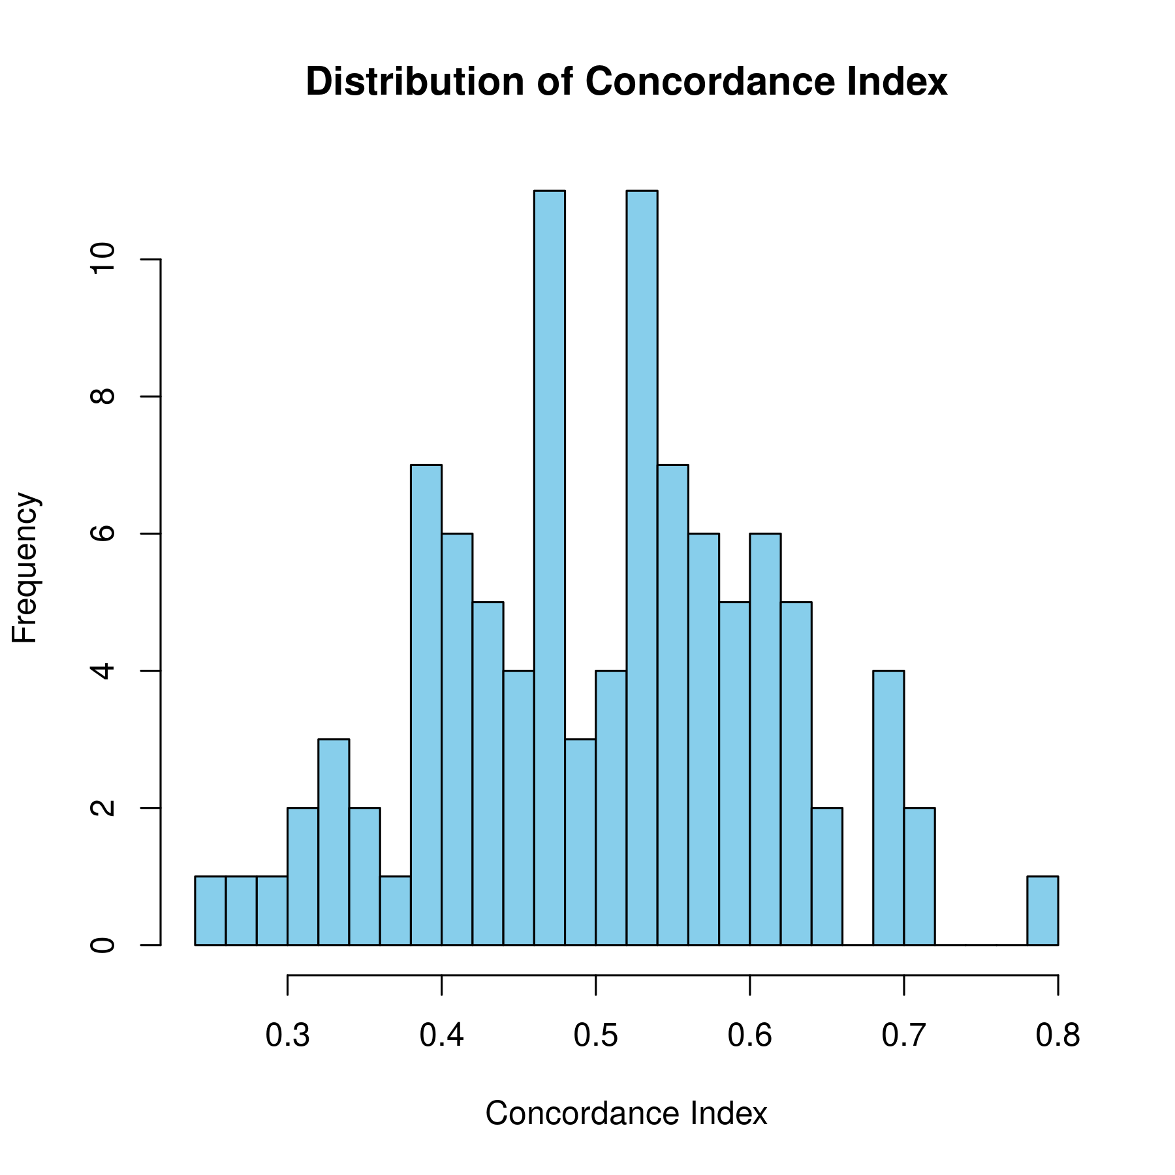
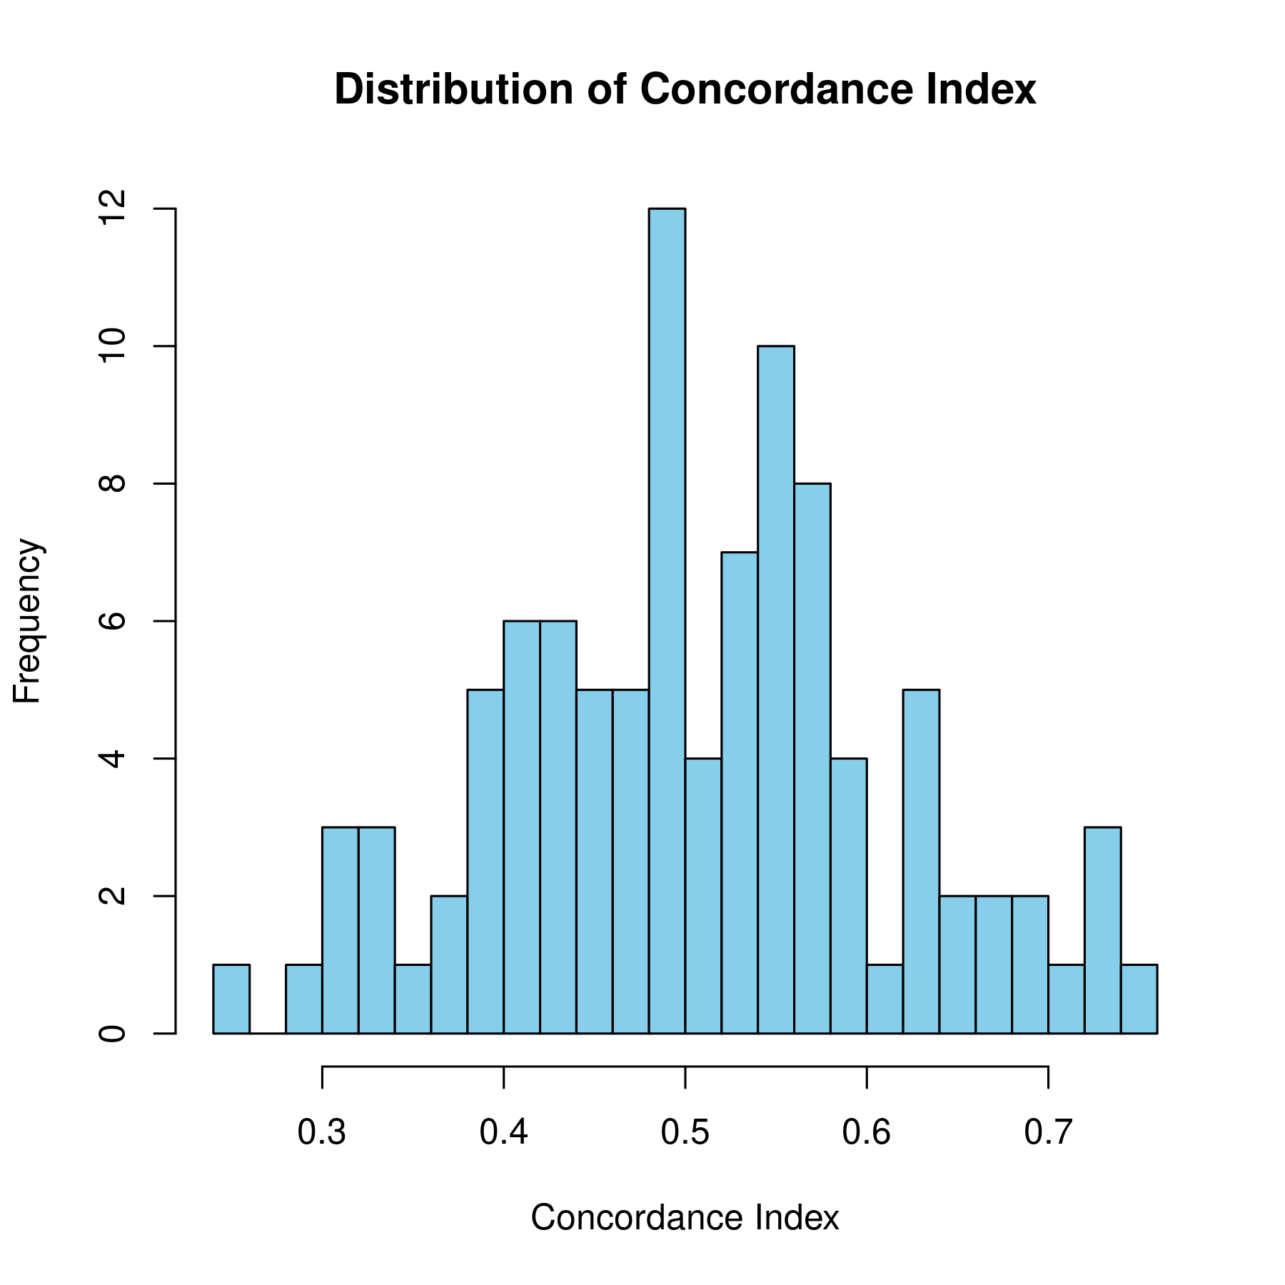
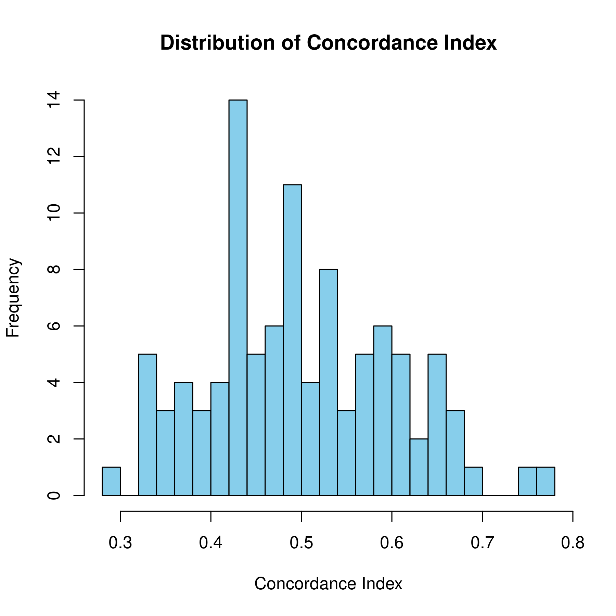
Survival Analysis
ADCYAP1 RSF
HAND2
RSF
ADCYAP1 + HAND2 RSF

Slide 14
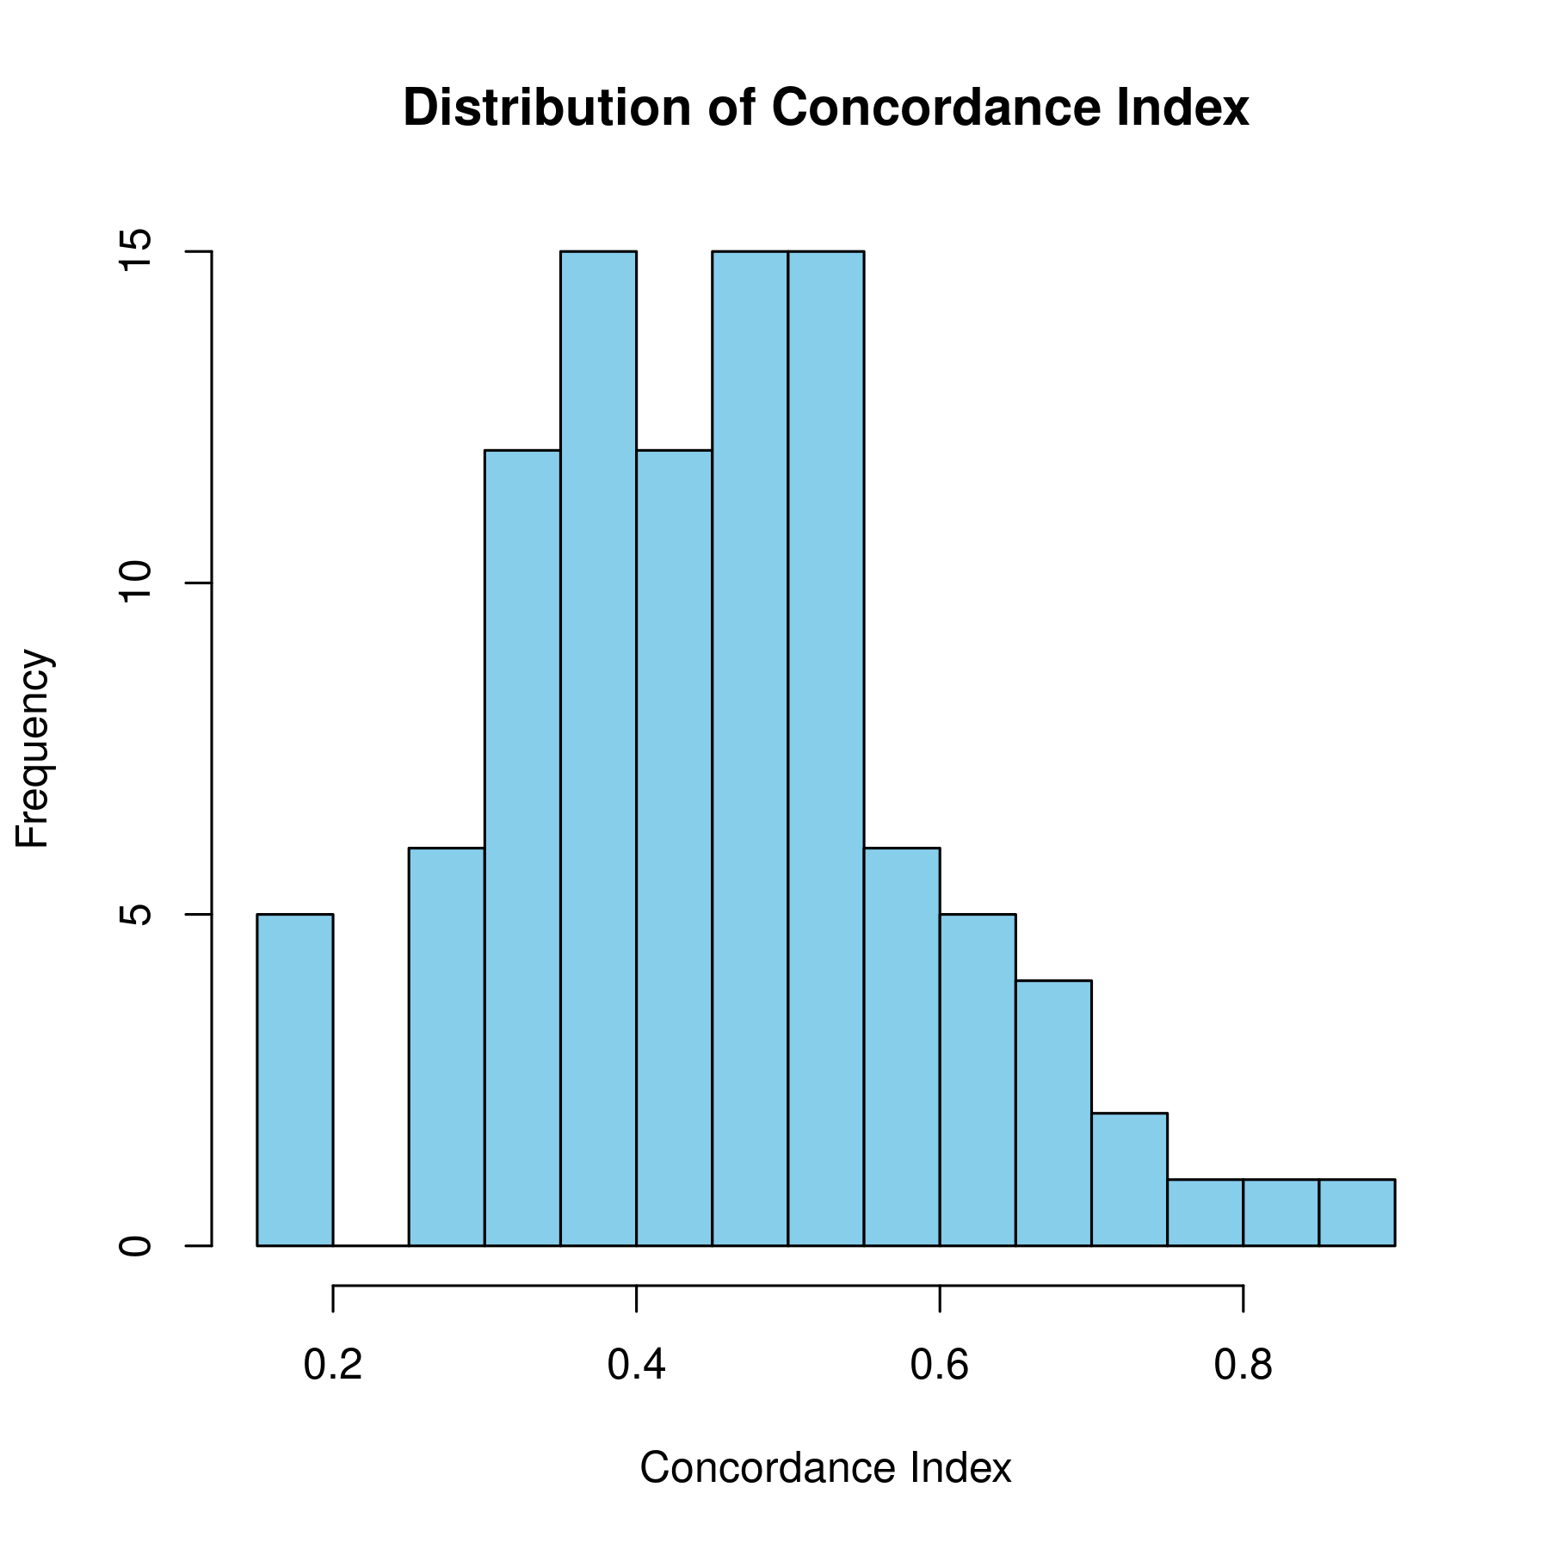
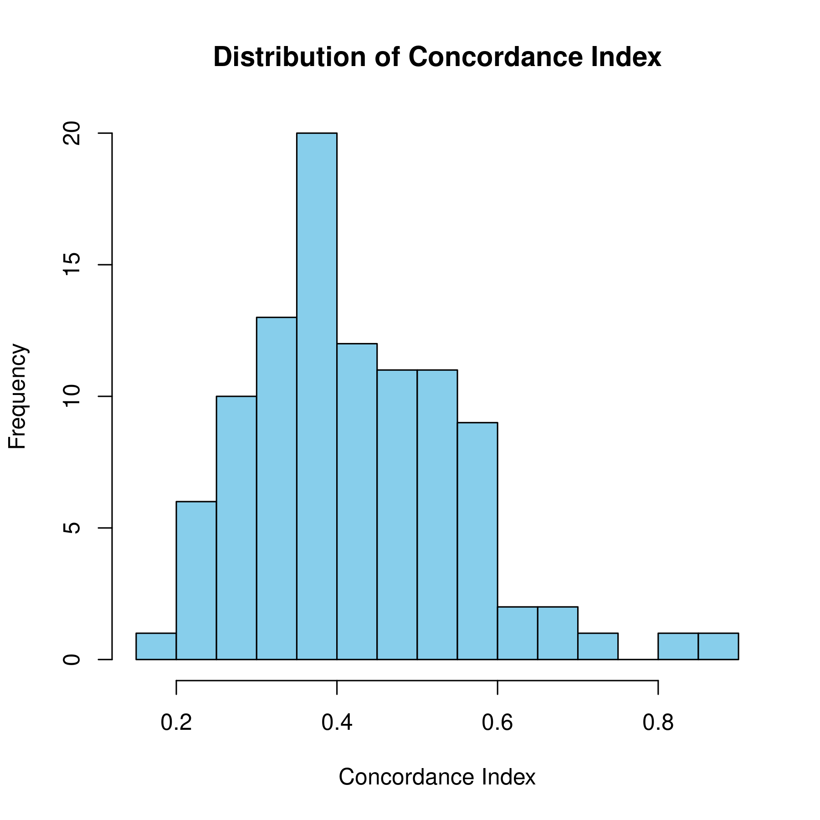
Survival Analysis (Future EC)
ADCYAP1 RSF
HAND2
RSF

Slide 15
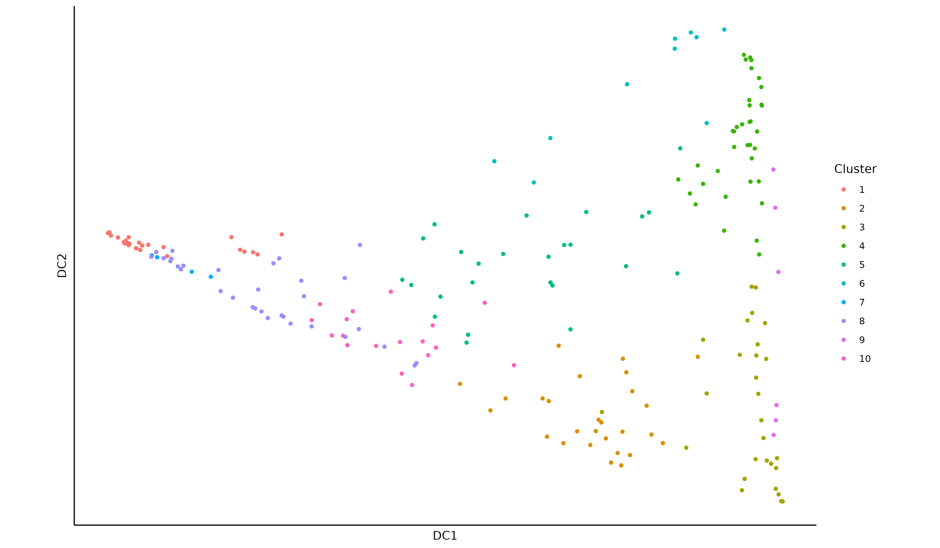
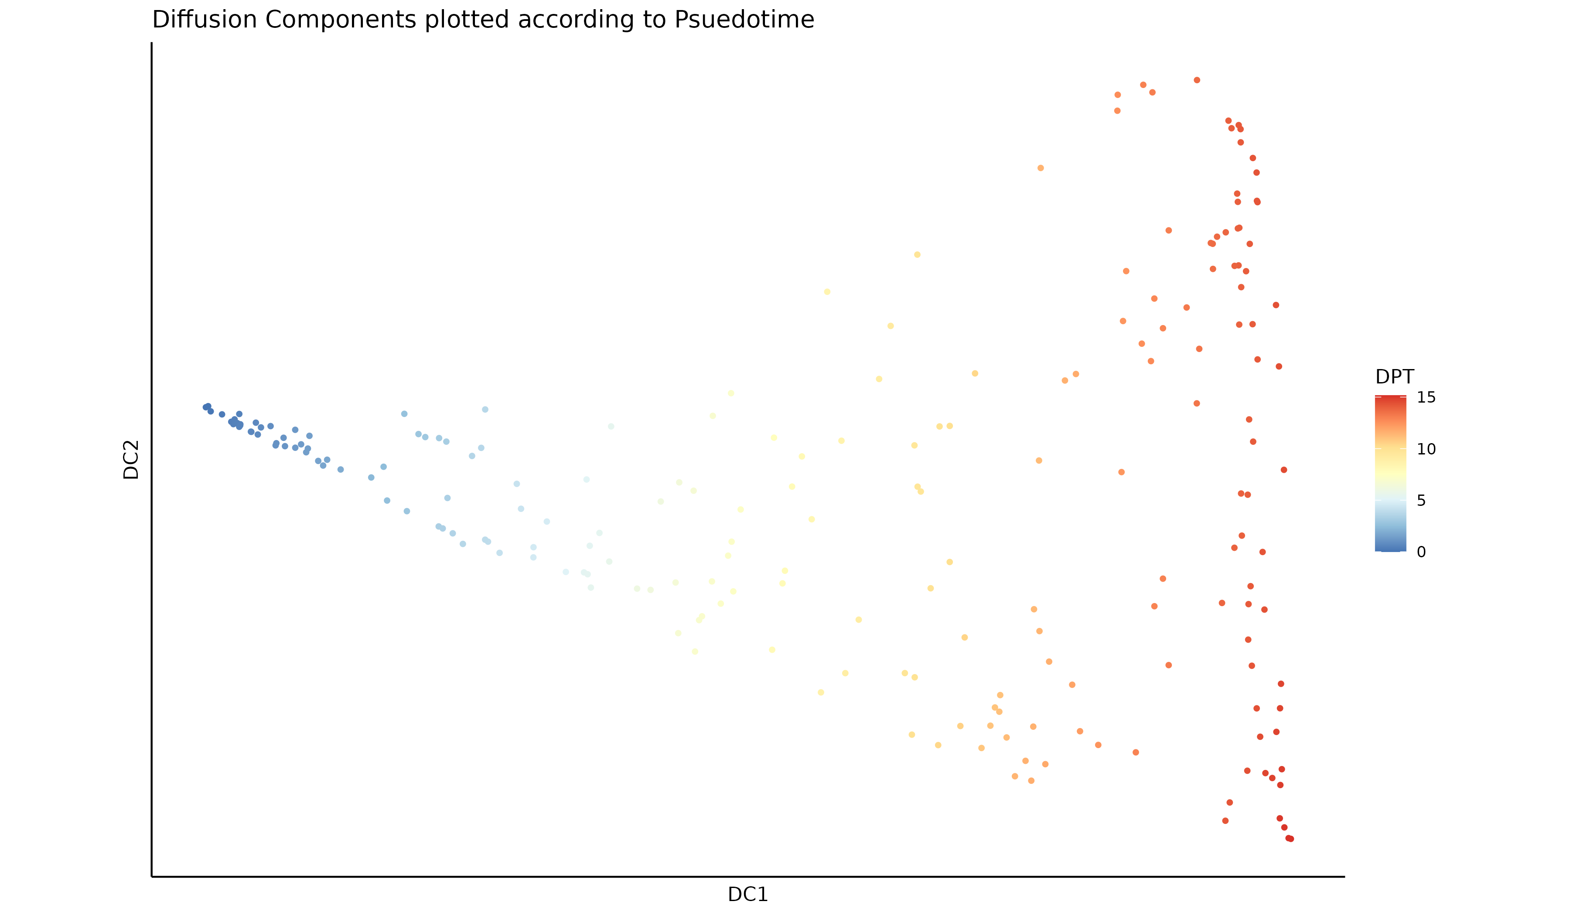
Psuedotime (HAND2 DNAm - TCGA)

Slide 16
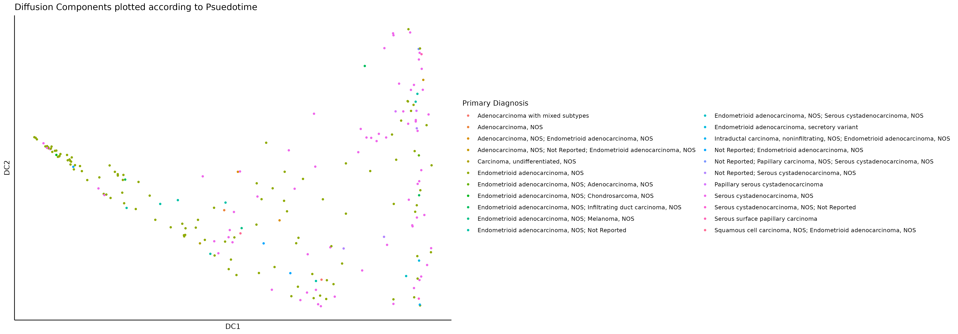
Psuedotime (HAND2 DNAm - TCGA)
Endometroid Adenocarcinoma
Serous Cystadenocarcinoma

Slide 17
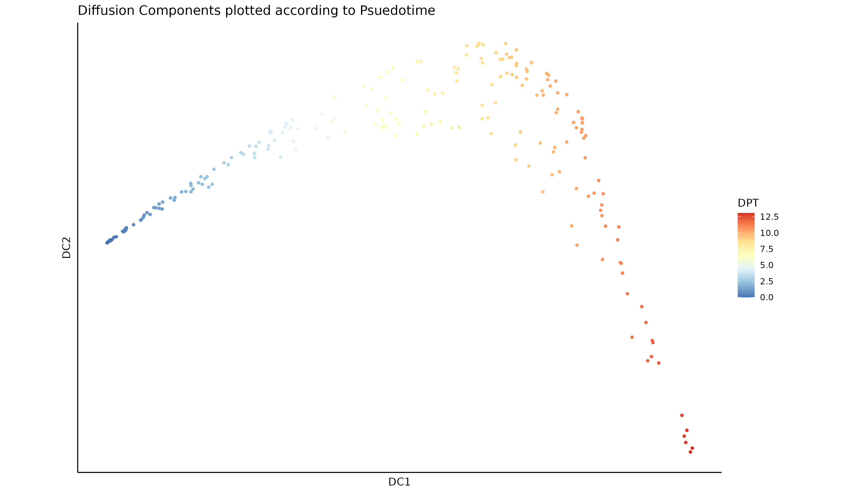
Psuedotime (HAND2 + ADCYAP1 DNAm - TCGA)

Slide 18
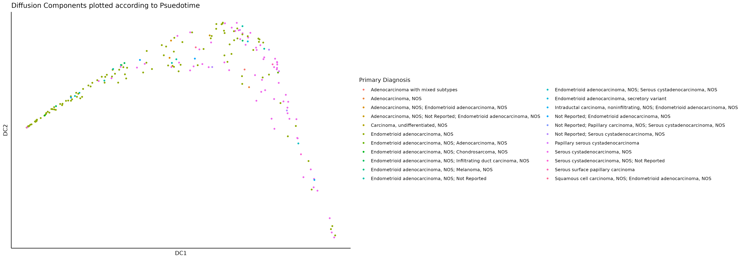
Psuedotime (HAND2 + ADCYAP1 DNAm - TCGA)
Endometroid Adenocarcinoma
Serous Cystadenocarcinoma

Slide 19
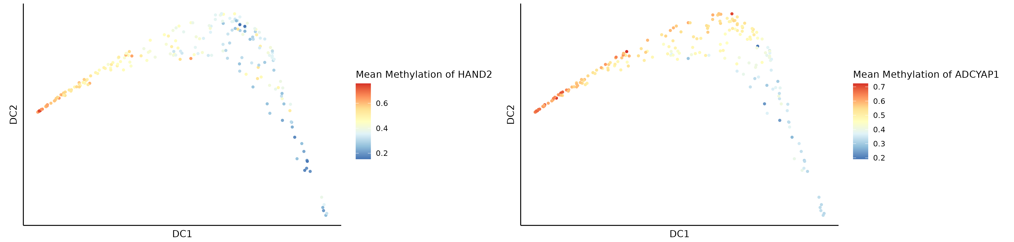
Mean Methylation (HAND2 + ADCYAP1)
Mean methylation of HAND2 and ADCYAP1 is lower in serous carcinomas

Slide 20
Feature Engineering (CpG x Gene)
Dataset: GSE263434
LM to identify probes significantly associated with gene expression (padj < 0.05)
Survival analysis
Psuedotime analysis
Weighted sum of CpG x Gene expression
PCA
$$Σ \left(β value of CpG × Coefficient\right)+RNAseq value of Gene$$
Spoilers: nothing worked

Slide 21
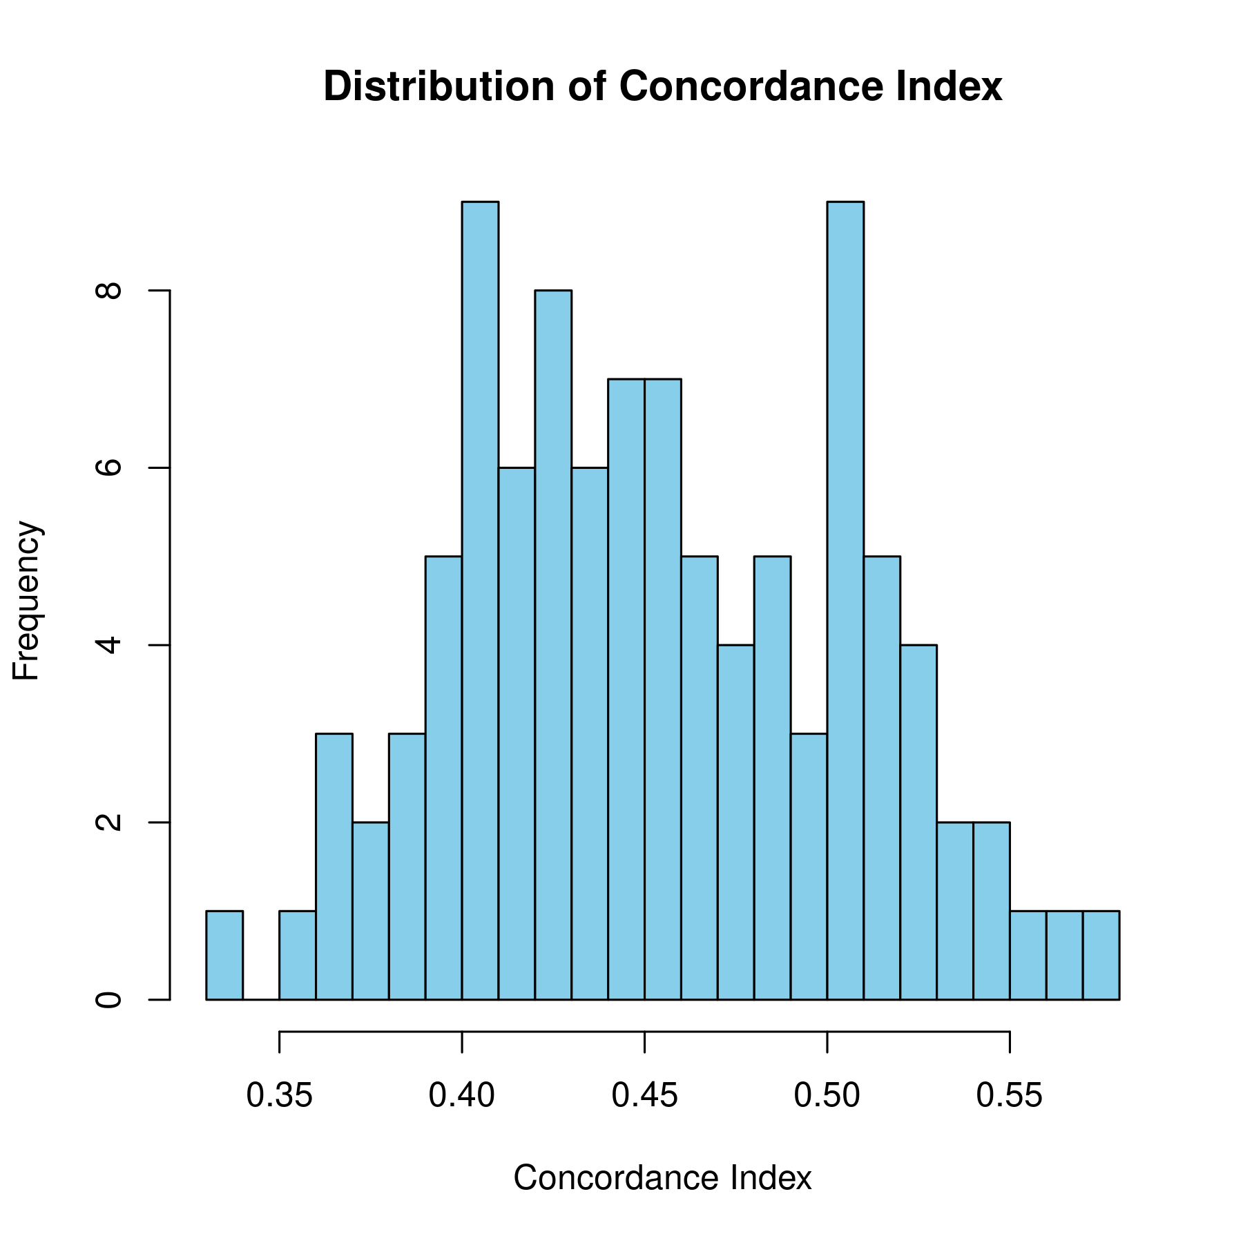
Engineered Features Survival Analysis
Bootstraps: 100
Model: Random survival forest (RSF).
Didn’t help much.
Neither did pseudotime.
So it was basically a waste.

Slide 22
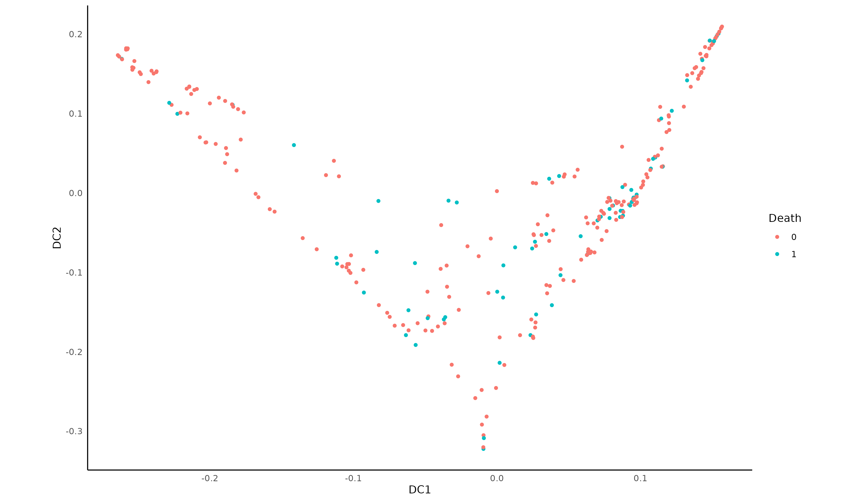
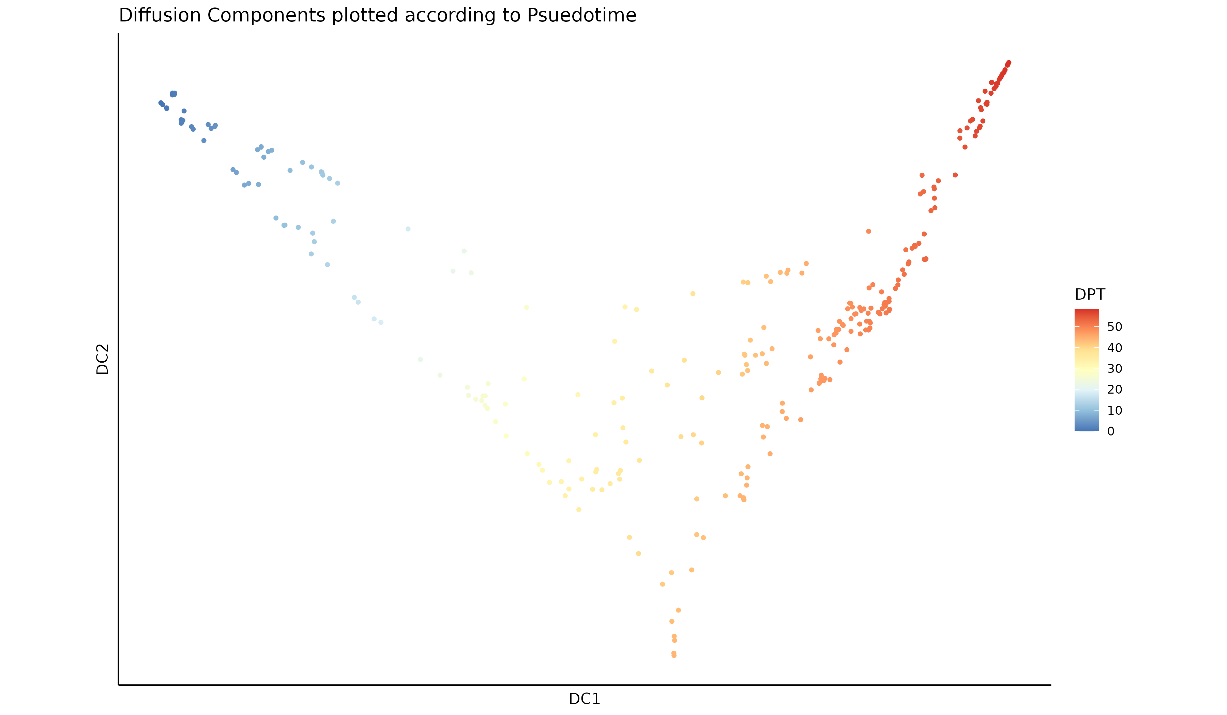
Psuedotime (Engineered Features)

Slide 23
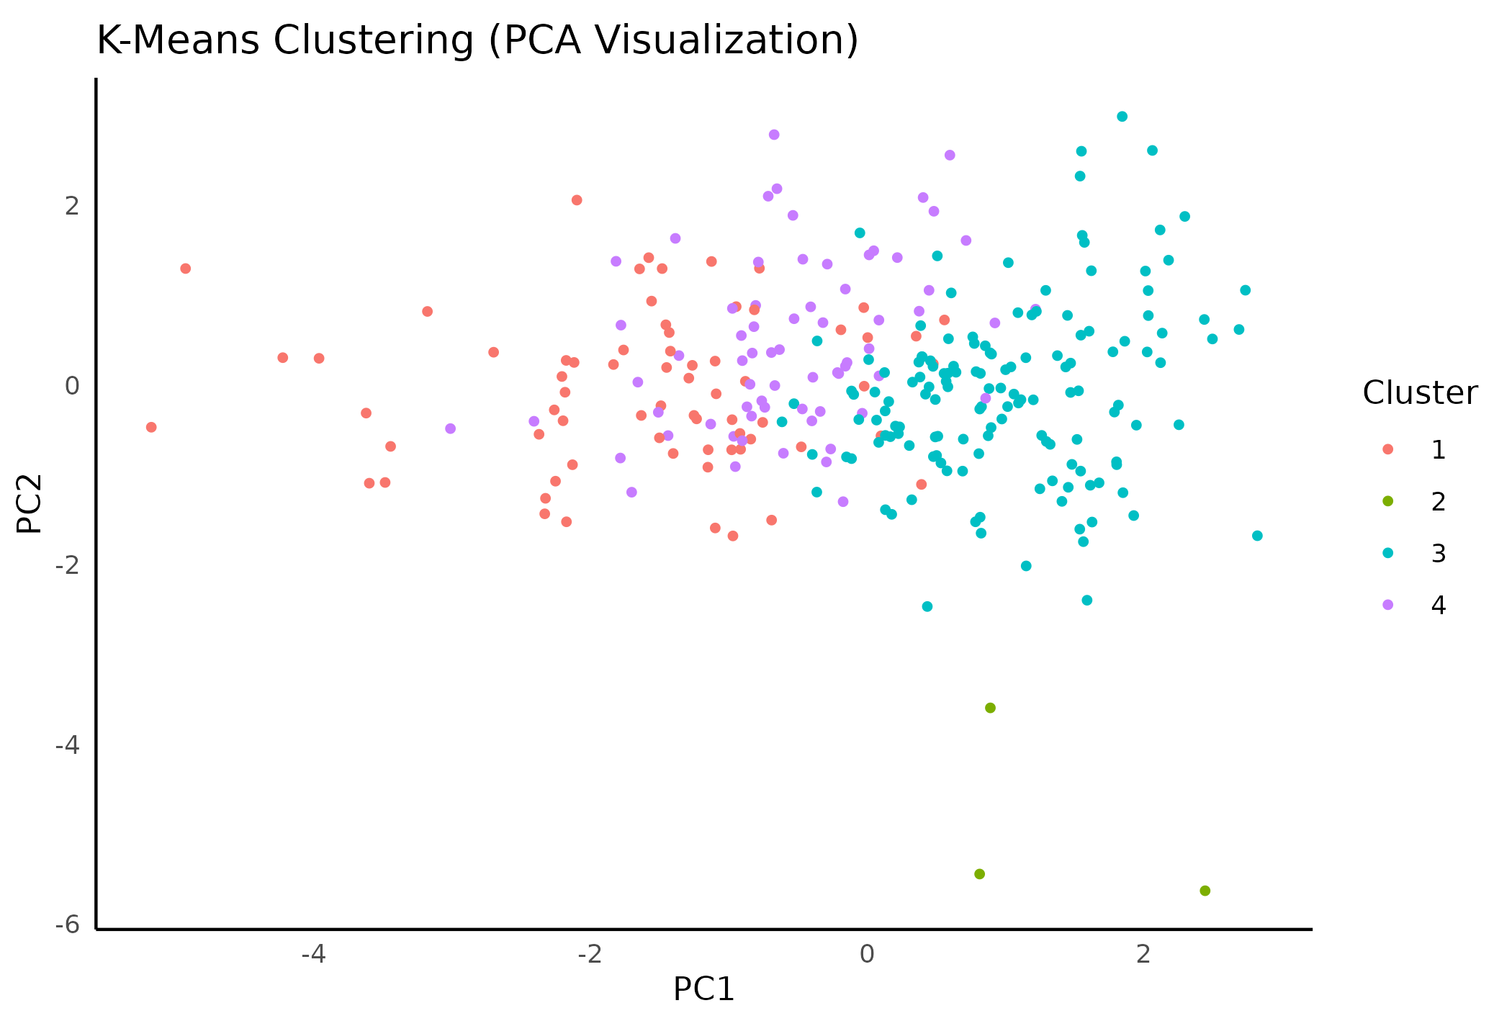
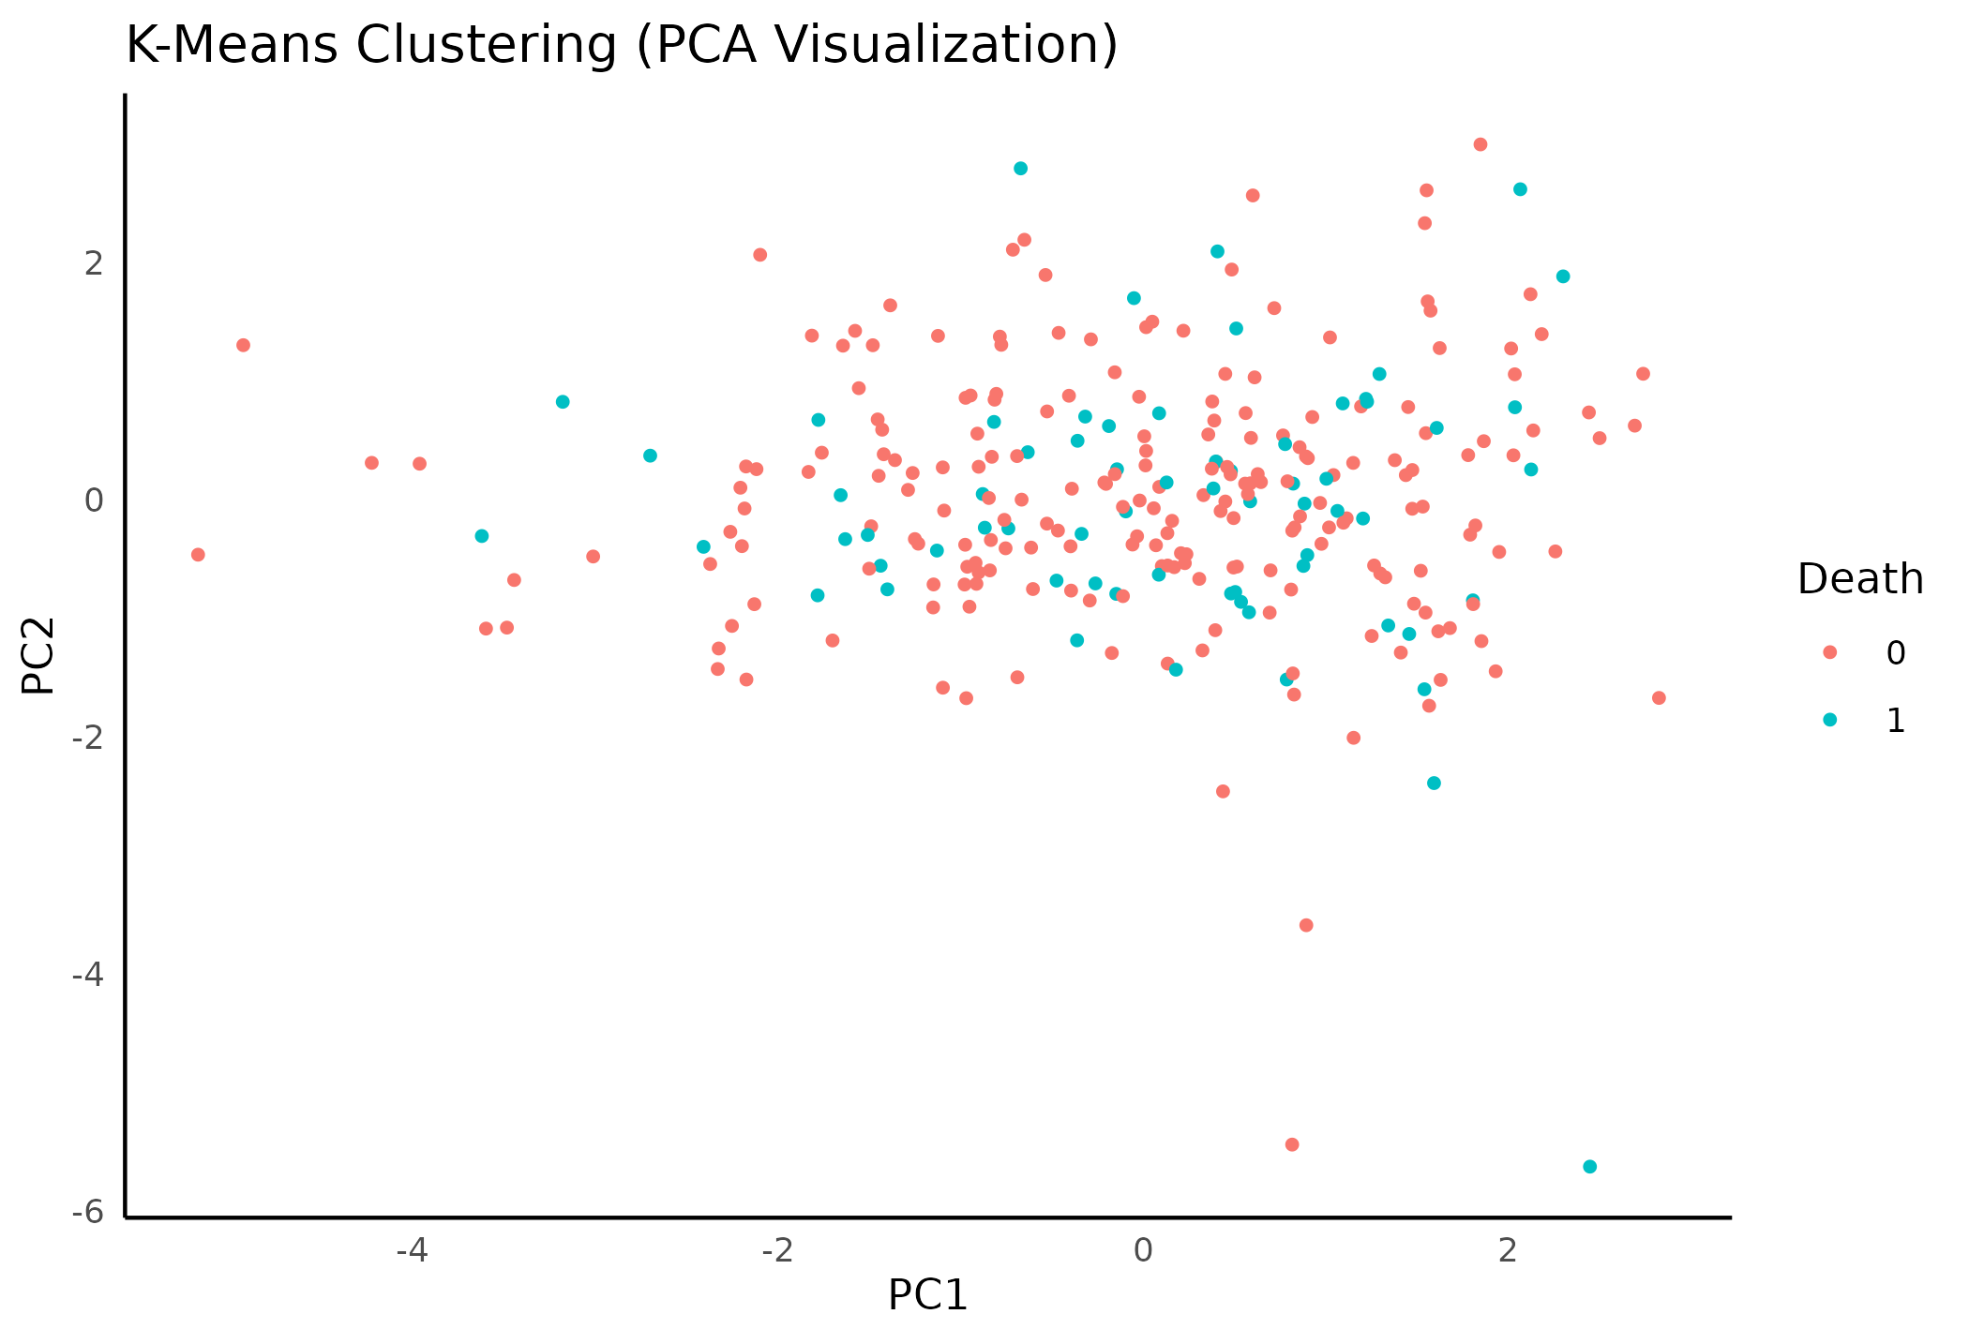
PCA (Engineered Features)

Slide 24
Future Directions
Investigating the differences in methylation of serous and endometrioid adenocarcinomas.
Self-supervised learning and extracting feature embeddings to find patterns in survival differences.
Check if methylation levels affect the expression of those genes in TCGA RNA-seq.

Slide 25

Thanks for Listening!
Happy to answer any questions :)

